Slide 1

Breast Cancer Prediction

Slide 2

TEAM MEMBERS
Varshitha Kollipara(S559892)
Naga Manikanta Chigurupati(S555681)
Narasimha RajKumar Madasu(S555231)
Surya Mohan Jagani (S560531)
Jyothsna Naredla(S559362)

Slide 3
GOALS OF THE PROJECT
The age group which are most –likely effected by the breast cancer stage 1.
The age group which are most –likely effected by the breast cancer stage 2.
Which treatment method is most likely used .
Finally, We are going to suggest the treatment method for people effected with different stages if cancer.

Slide 4
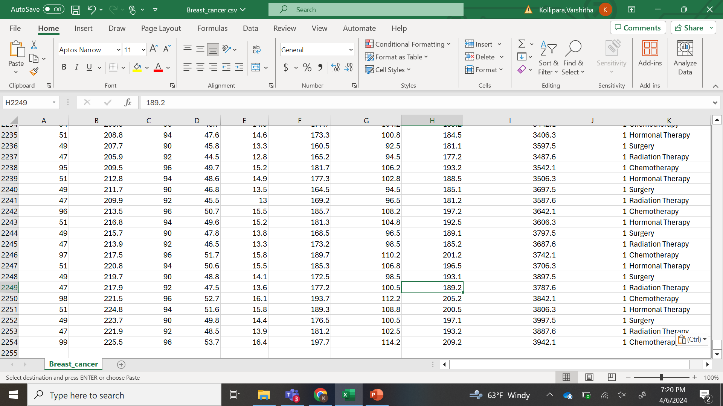
Contd(…..)
It contains 11 columns .
It contains 2254 records
Notes:
We have got the dataset from Kaggle and our dataset contains 11 columns and 2254 records as you can see in the screenshot.

Slide 5
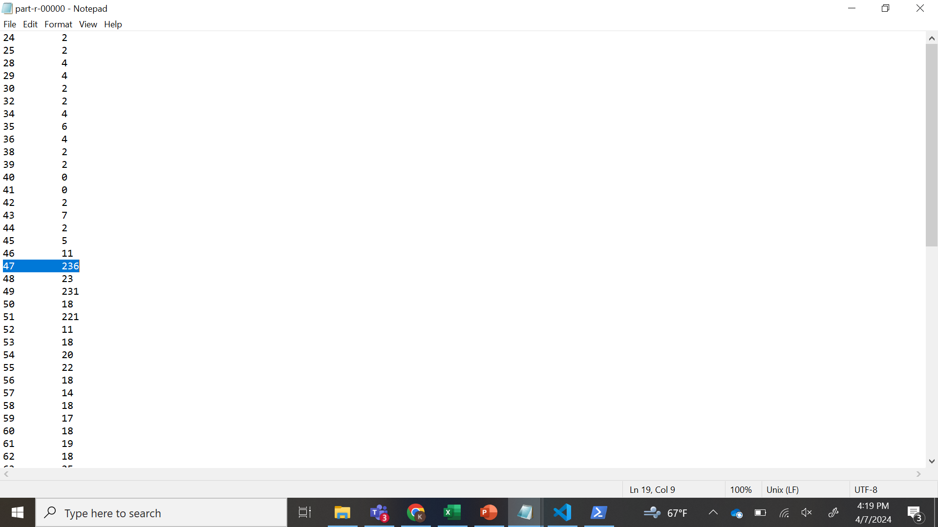
GOAL 1
The age group which are most –likely effected by the breast cancer stage 1.
Notes:
we have set 4 goals to be done as of now we completed one goal ,i.e the age group which are mostly effected by breast cancer stage 1 .We have used map reduce to complete this goal ,as you can see we have the age and the count of the patients effected. The people with age group 47 are mostly effected.

Slide 6
MAPPER CODE
The code extracts age and breast cancer status from individual data.
It organizes individuals by pairing their age with their cancer status.

Slide 7
REDUCER CODE
Receives grouped data from the mapper.
Counts the occurrences of classification number 1 (presumably representing breast cancer stage 1) for each age group.
Outputs the age group along with the count of occurrences of breast cancer stage 1.

Slide 8
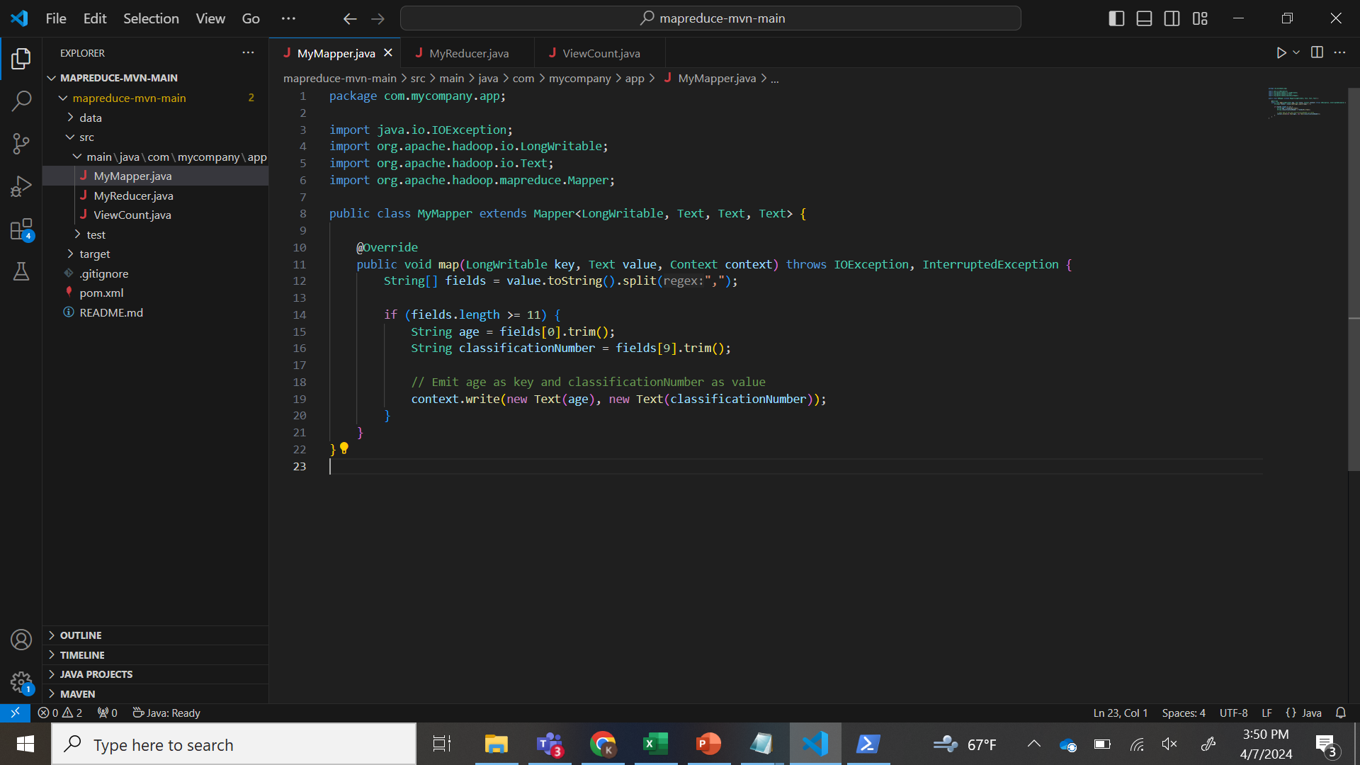
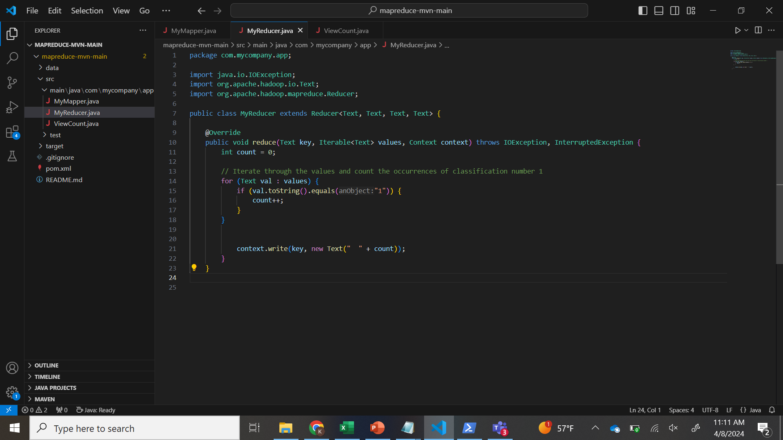
SNAPSHOT OF MAPPER &REDUCER CODE

Slide 9
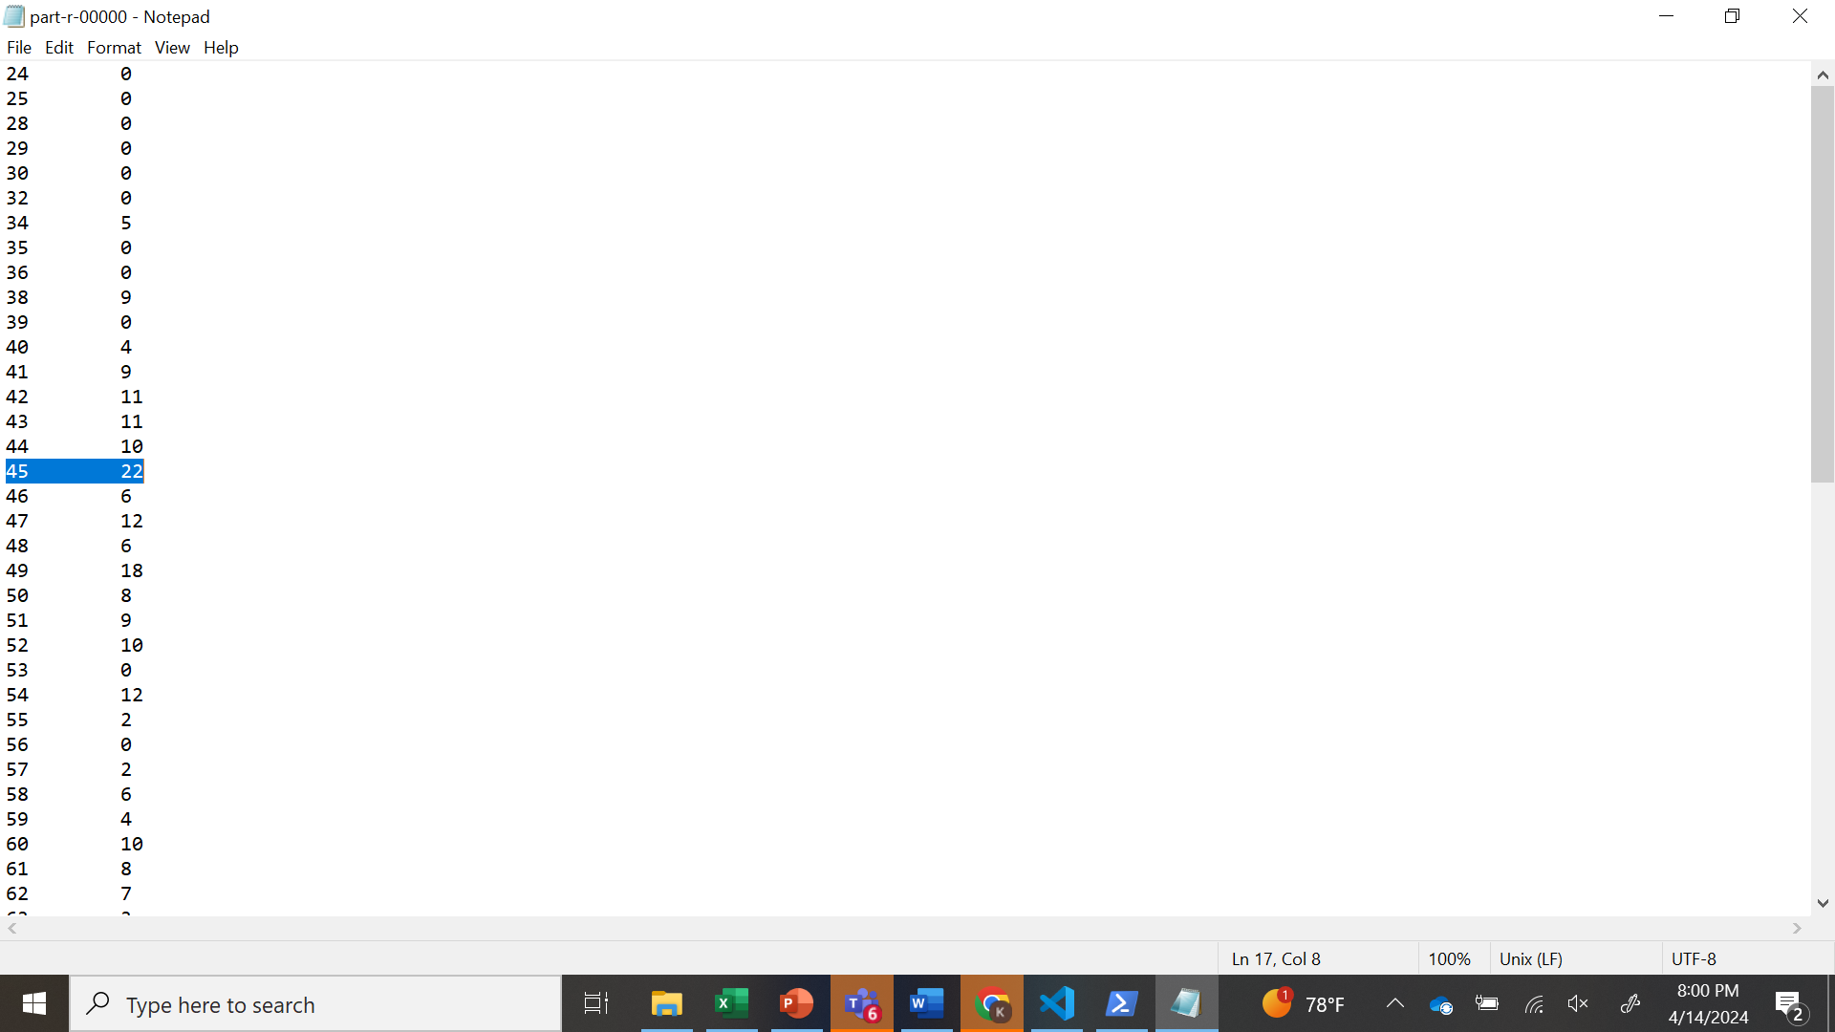
GOAL 2
The age group which are most –likely effected by the breast cancer stage 2.
Notes:
we have set 4 goals to be done as of now we completed one goal ,i.e the age group which are mostly effected by breast cancer stage 1 .We have used map reduce to complete this goal ,as you can see we have the age and the count of the patients effected. The people with age group 47 are mostly effected.

Slide 10
MAPPER CODE
Reads lines of data.
Splits each line into fields using commas.
Checks if there are at least 11 fields.
Extracts the age (first field) and classification number (tenth field).
Emits age as the key and classification number as the value.

Slide 11
REDUCER CODE
Receives grouped data from the mapper.
Counts the occurrences of classification number 2 (presumably representing breast cancer stage 2) for each age group.
Outputs the age group along with the count of occurrences of breast cancer stage 2.

Slide 12
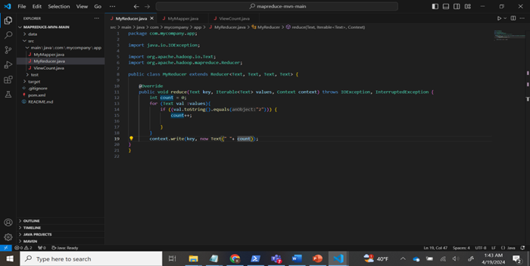
SNAPSHOT OF MAPPER &REDUCER CODE

Slide 13
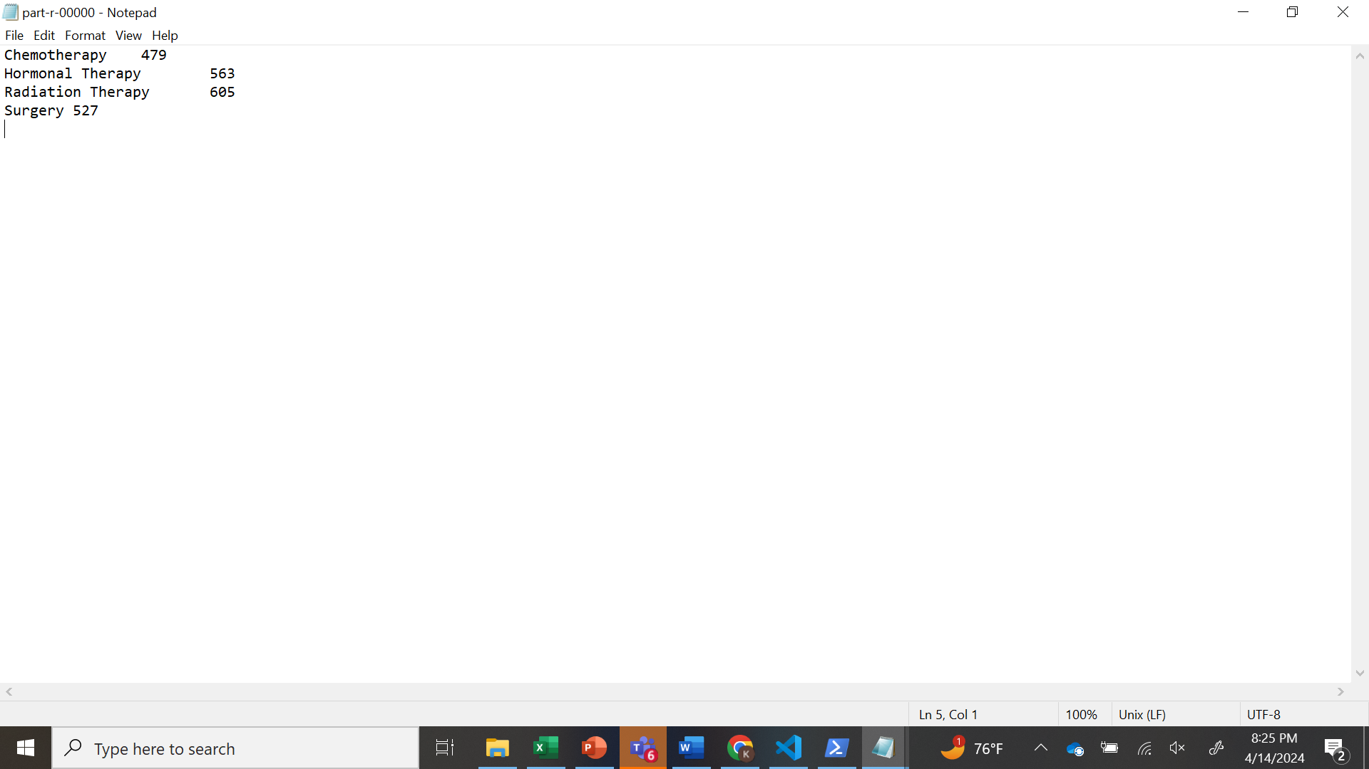
GOAL 3
Which treatment method is most likely used .
Notes:
we have set 4 goals to be done as of now we completed one goal ,i.e the age group which are mostly effected by breast cancer stage 1 .We have used map reduce to complete this goal ,as you can see we have the age and the count of the patients effected. The people with age group 47 are mostly effected.

Slide 14
MAPPER CODE
Reads each input lineParses the line and splits it into fields using a comma as the delimiter.
Extracts the treatment method from the appropriate field.
The emitted key-value pairs are then shuffled and sorted by the framework before being passed to the reducer.

Slide 15
REDUCER CODE
Receives key-value pairs where the key is a treatment method and the value is a list of counts.
Iterates through the list of counts for each treatment method.
Aggregates the counts to calculate the total occurrences of each treatment method.

Slide 16
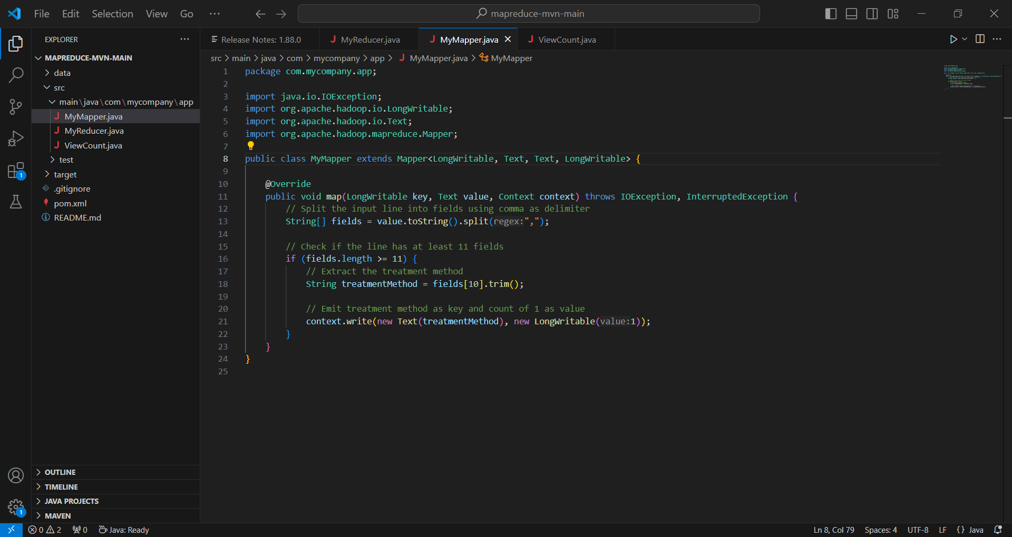
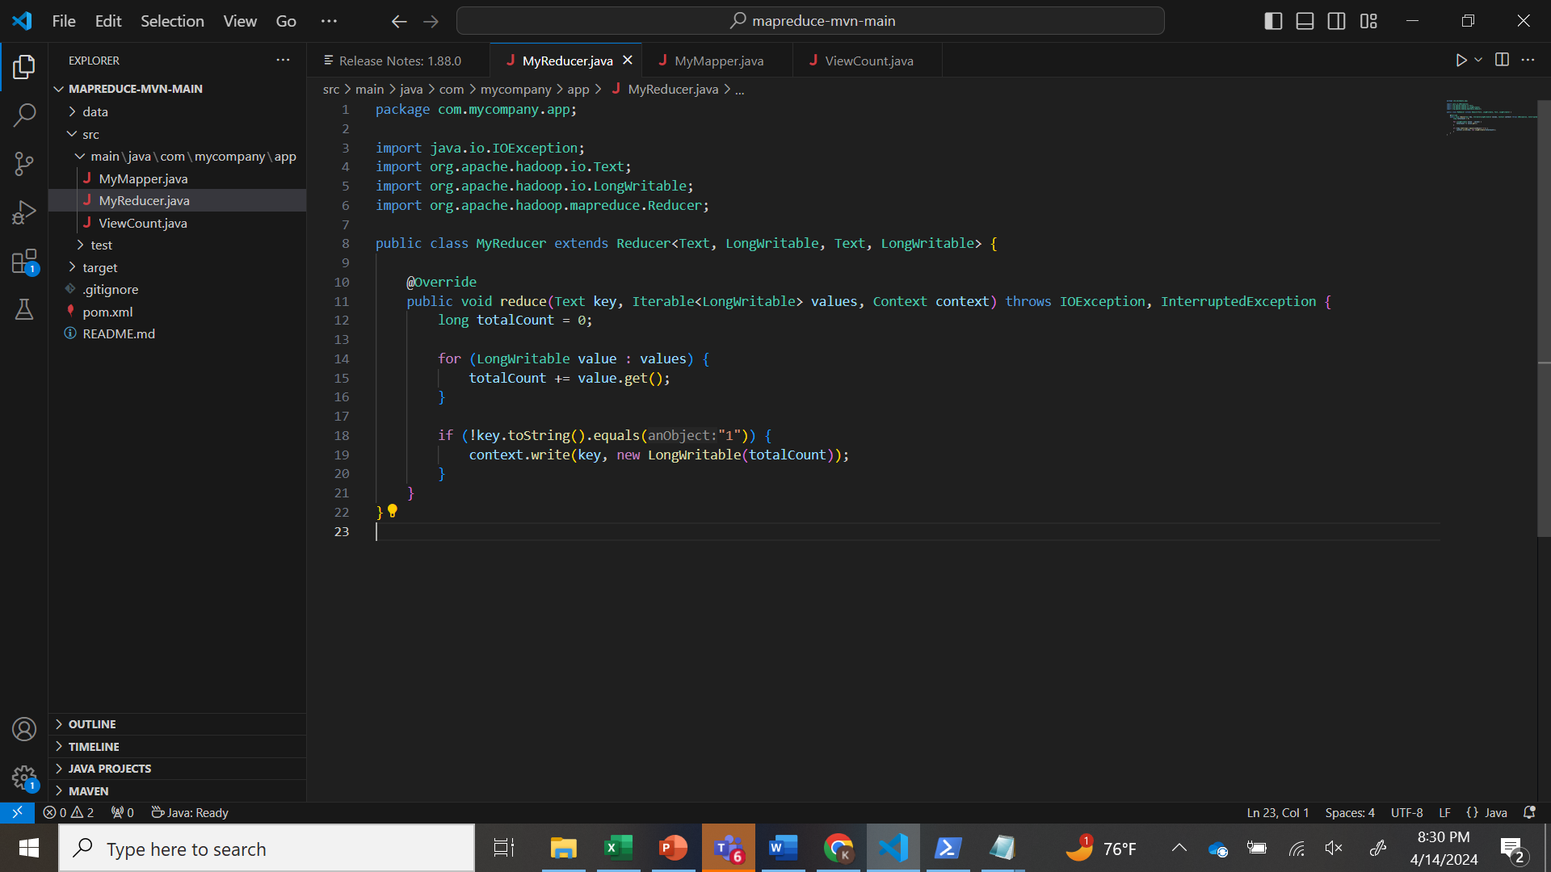
SNAPSHOT OF MAPPER &REDUCER CODE

Slide 17

GOAL 4
Finally, We are going to suggest the treatment method for people effected with different stages if cancer.
Notes:
we have set 4 goals to be done as of now we completed one goal ,i.e the age group which are mostly effected by breast cancer stage 1 .We have used map reduce to complete this goal ,as you can see we have the age and the count of the patients effected. The people with age group 47 are mostly effected.

Slide 18
MAPPER CODE
Receives each input record.
Extracts the classification and treatment method from each record.
Emits key-value pairs where the key is the classification and the value is the treatment method.

Slide 19
REDUCER CODE
Receives key-value pairs grouped by classification.Iterates through the list of counts for each treatment method.
Counts the occurrences of each treatment method for each classification.
Determines the treatment method with the highest count for each classification.

Slide 20
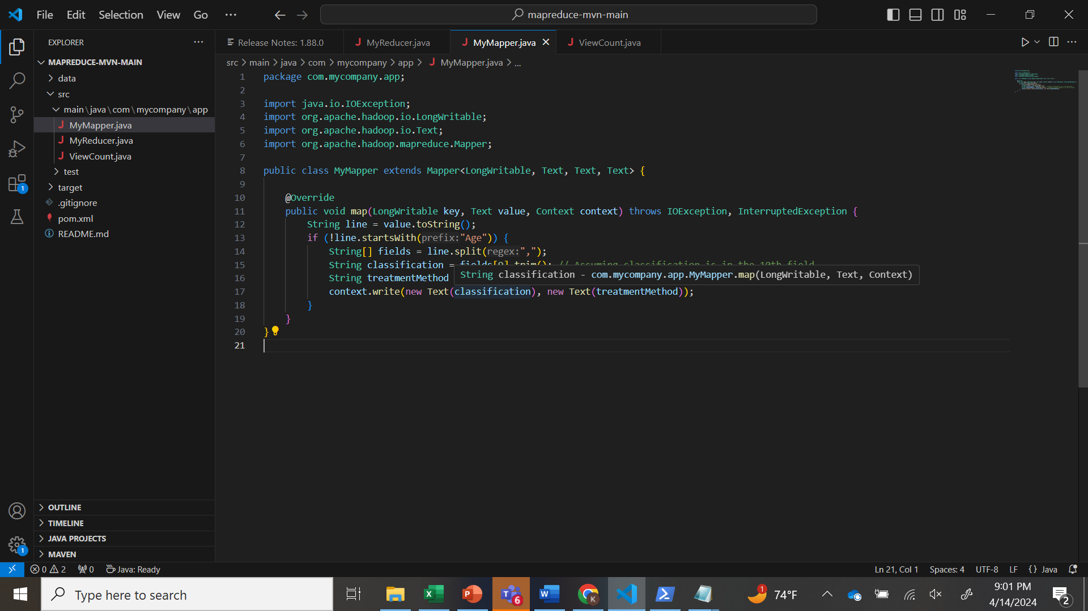
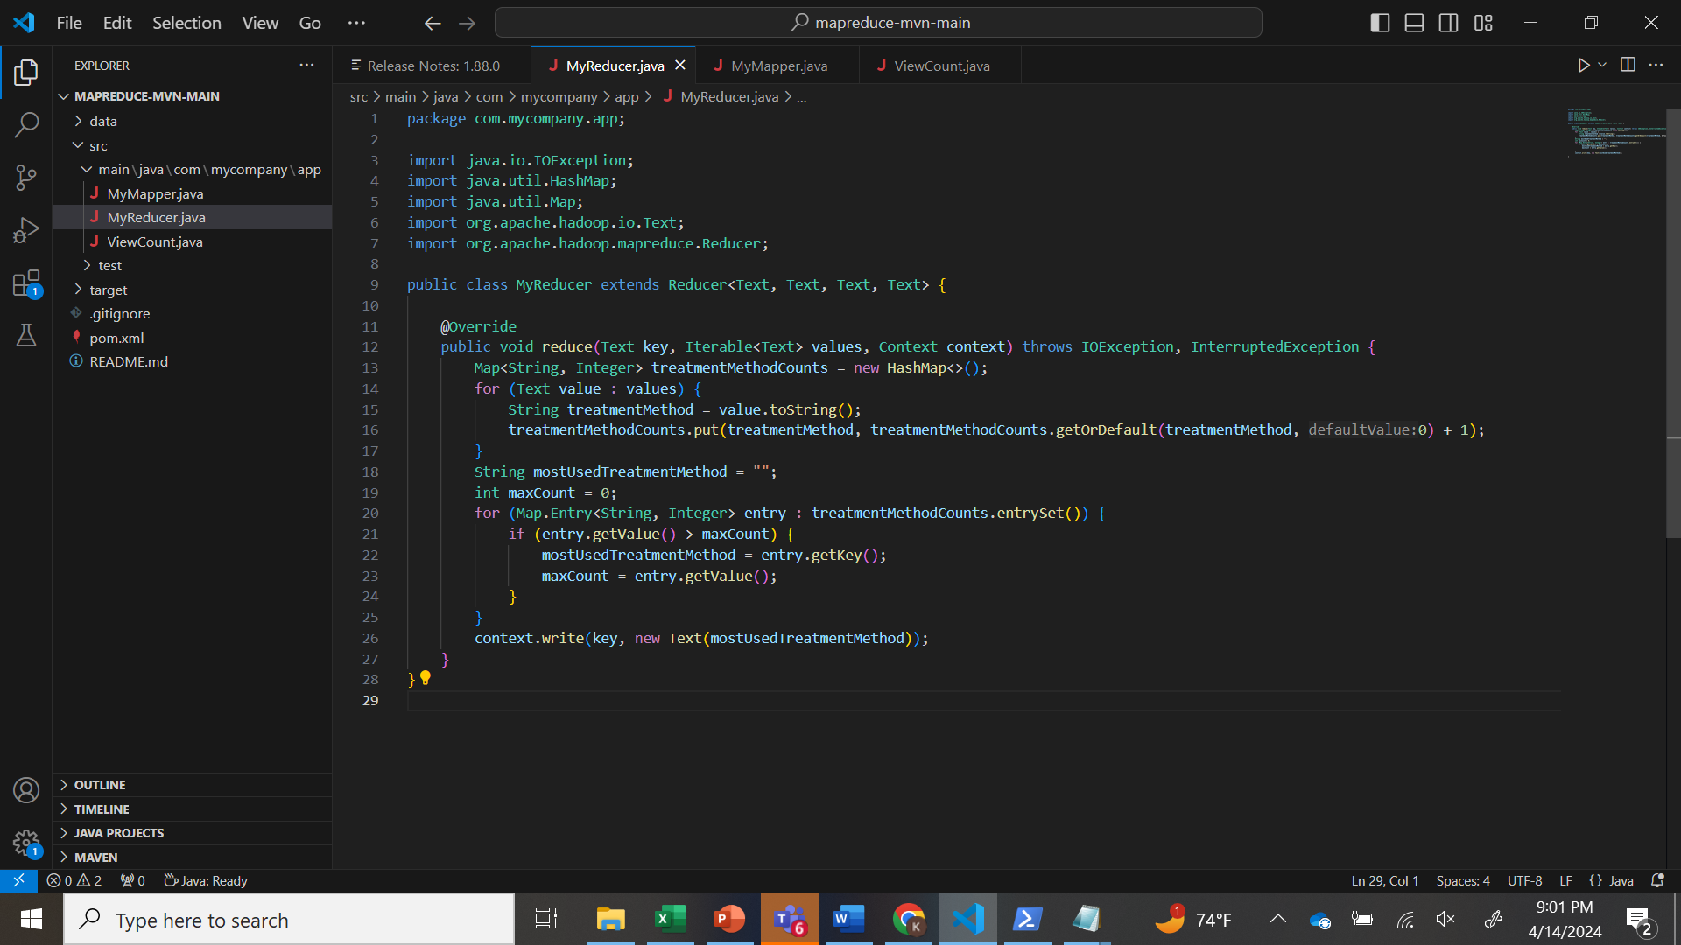
SNAPSHOT OF MAPPER &REDUCER CODE

Slide 21
PROBLEMS FACED
We have faced issued with the data since it is csv so we have converted the data into the text file and we have succeded.
Initially we have received errors in mapper code we didn’t map the correct records.
We have faced problem in reducer code in the logic with the count++ for the count of treatment method.

Slide 22
CONCLUSION
Age Group Most Likely Affected by Breast Cancer Stage 1 (Goal 1):
The age group most likely affected by breast cancer stage 1 is 47.
Age Group Most Likely Affected by Breast Cancer Stage 2 (Goal 2):
The age group most likely affected by breast cancer stage 2 is 45.
Most Likely Used Treatment Method (Goal 3):
The most likely used treatment method is Radiation Therapy.
Suggested Treatment Method for People Affected with Different Stages of Cancer (Goal 4):
For people affected by breast cancer stage 1, the suggested treatment method is Surgery.
For people affected by breast cancer stage 2, the suggested treatment method is Radiation Therapy.
These conclusions provide valuable insights into the demographics affected by different stages of breast cancer and the treatment methods commonly used for each stage.

Slide 23

THANK YOU

